Slide 1

November 2022
Book Recommender System
A Customer Journey
A presentation by:
Nittala Aditya, Soumya Agrawal, Manvi Goyal, Vishwak Venkatesh, Soumith Reddy

Slide 2





Meet the Team!
Nittala Venkata Sai Aditya
Soumya Agrawal
Soumith Palreddy
Vishwak Venkatesh
Manvi Goyal

Slide 3


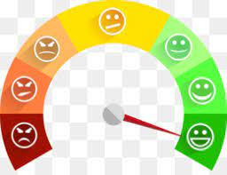

Why recommend books?
Increase Web traffic
Customer Retention
Enhance Shopping Experience
Shorter Conversion Time

Slide 4
Dataset Description
Dataset Overview:
Webscraped data from goodreads.com which contains 10,000 books across multiple genres having user ratings and other attributes.
Files:
BooksEnriched.csv: Contains book level information such as book_id, name, author, ratings, published year, pages, title, etc.
Ratings.csv: Contains user ratings for the books
Tags.csv: Contains ”tags” used on goodreads which enables the users to search by a given tag
Datasets reference : https://drive.google.com/drive/u/0/folders/1XsWas9e14lLG5Ij8mFgpQIINo4AvPUSK

Slide 5
OBJECTIVES
KNN Based Recommendations with Euclidean distance and cosine metrics
User based Collaborative Filtering to recommend books based on past user history
Item based Collaborative Filtering using Cosine Similarity, Correlation and Matrix Decomposition
EDA/Other Questions to answer:
Average ratings by publication year?
Top rated books?
What are the genres that users prefer?
Datasets reference : https://drive.google.com/drive/u/0/folders/1XsWas9e14lLG5Ij8mFgpQIINo4AvPUSK

Slide 6
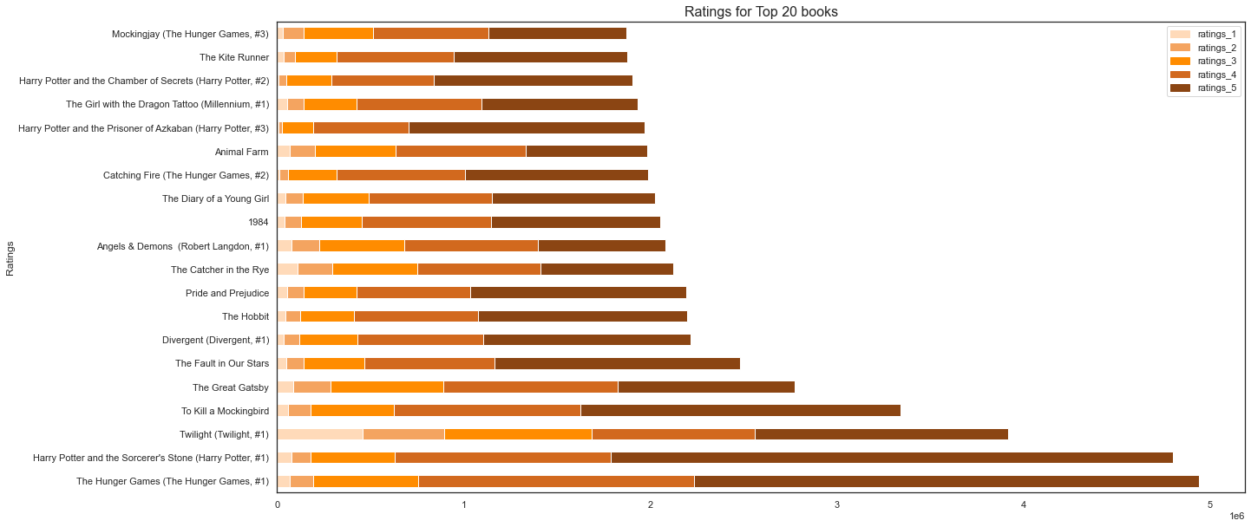
EDA – Top 20 Book Ratings
good number of twilight haters!
Notes:
Most top books have a lot of 5 & 4 star ratings, Twilight very polarizing

Slide 7
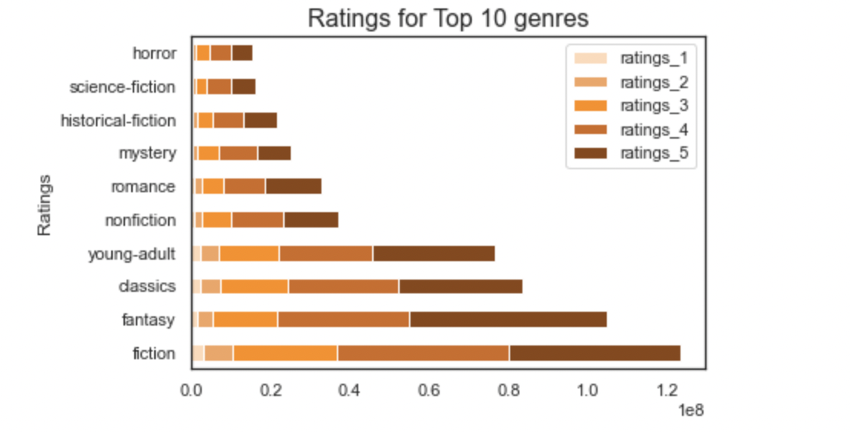
EDA – Ratings for Top 10 genres
Notes:
Dominated by fiction, fantasy, classics & young-adult books. Huge drop off after big 4

Slide 8
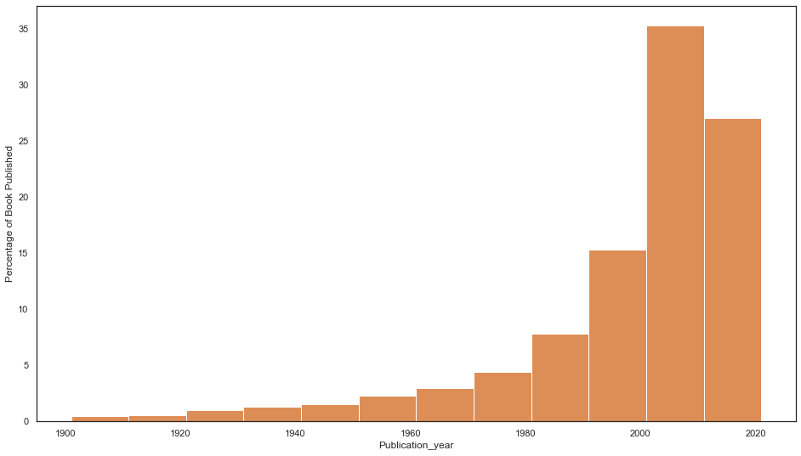
EDA – Distribution of Publication Year

Slide 9
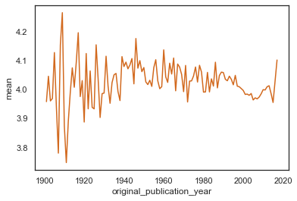
EDA – Average ratings by Publication year

Slide 10
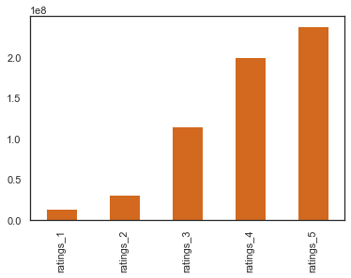
EDA – Frequency of Ratings Score
Notes:
The ratings score range from 1 to 5

Slide 11
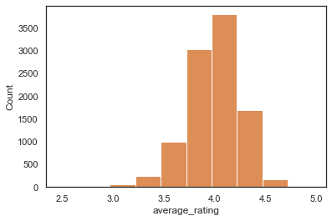
EDA – # Books by Average Ratings

Slide 12
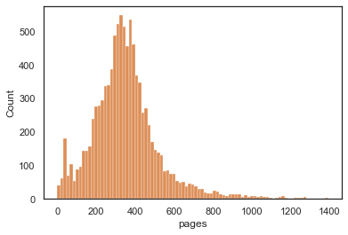
EDA – # books by no of pages

Slide 13
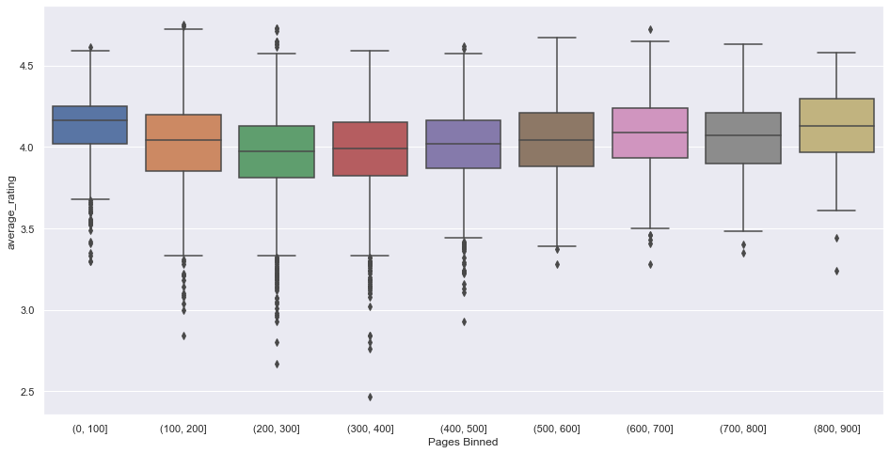
EDA – Average Rating by Pages Bins

Slide 14
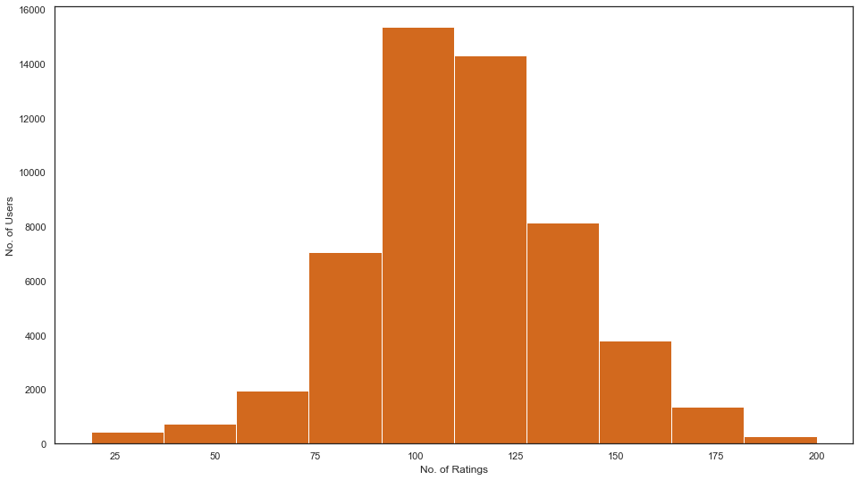
EDA – # of Ratings by Users
Summary Statistics
Min | 19
Median | 111
Max | 200
Notes:
Most users have rated between 75-150 times

Slide 15
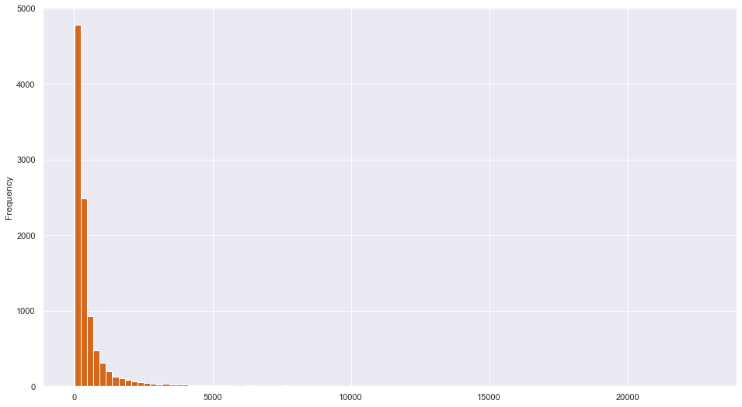
EDA – Book Rating Frequency
Notes:
Most books rated few number of times, very few books rated a lot of times

Slide 16
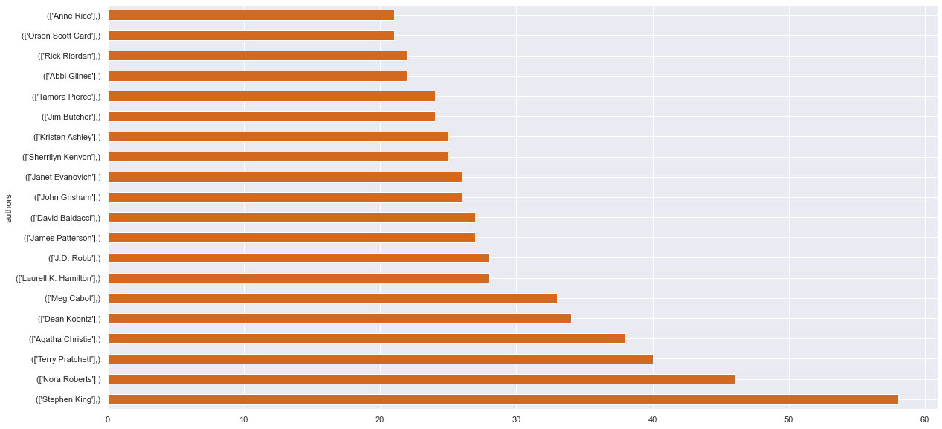
EDA – Top 20 Author Book Count
Notes:
Most books rated few number of times, very few books rated a lot of times

Slide 17



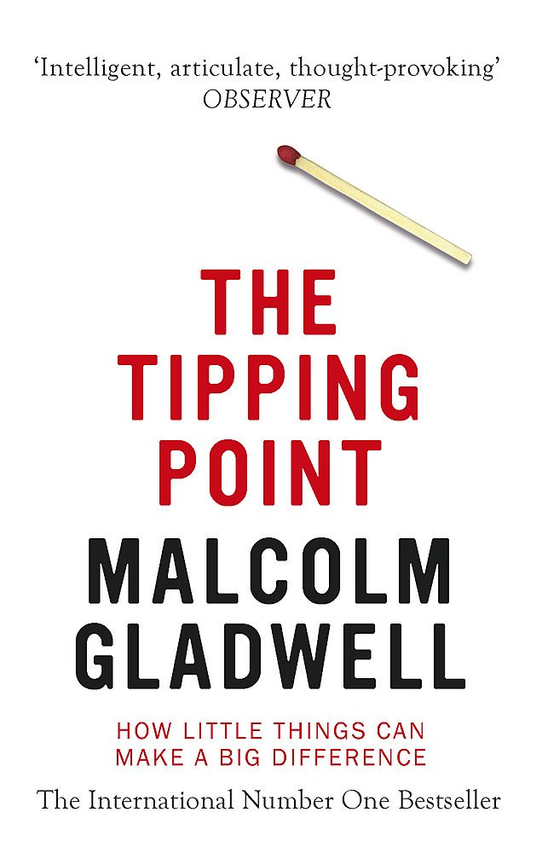
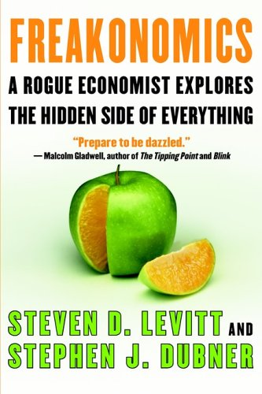
Naïve Recommendations – KNN based on Cosine Similarity
First Time User
Meet Fredrick!
Recommendation
Let me checkout this new site!
Notes:
Freakonomics - The Tipping Point: How Little Things Can Make a Big Difference, Blink: The Power of Thinking Without Thinking, SuperFreakonomics: Global Cooling, Patriotic Prostitutes And Why Suicide Bombers Should Buy Life Insurance
The Alchemist - The Kite Runner, The Da Vinci Code, To Kill a Mockingbird

Slide 18

Naïve Recommendations – KNN based on Euclidian Distance
First Time User
Meet Fredrick!
Recommendation
Let me checkout this new site!
Notes:
Freakonomics - The Tipping Point: How Little Things Can Make a Big Difference, Blink: The Power of Thinking Without Thinking, SuperFreakonomics: Global Cooling, Patriotic Prostitutes And Why Suicide Bombers Should Buy Life Insurance
The Alchemist - The Kite Runner, The Da Vinci Code, To Kill a Mockingbird

Slide 19
Moving to Repeat Users
Transit
I’m loving this site!!
Newbie Fredrick!
Bibliophile Fredrick!
Fredrick loves our site and turns into an avid reader! Now that we know what Fredrick likes let’s recommend books using a different strategy
Notes:
Freakonomics - The Tipping Point: How Little Things Can Make a Big Difference, Blink: The Power of Thinking Without Thinking, SuperFreakonomics: Global Cooling, Patriotic Prostitutes And Why Suicide Bombers Should Buy Life Insurance
The Alchemist - The Kite Runner, The Da Vinci Code, To Kill a Mockingbird

Slide 20
Collaborative Filtering
Collaborative ﬁltering (CF) is a technique commonly used to build personalized recommendations.
Here, algorithms are used to make automatic predictions about a user’s interests by compiling preferences from several users with similar interests.
Definition
The method identiﬁes users that are similar to the queried user and estimate the desired rating to be the weighted average of the ratings of these similar users.
User Based
This method looks for items that are similar to those that the user has already rates and recommends the most similar ones
Item Based

Slide 21
Collaborative Filtering – User Based
Repeat User
Books Name | Rating
Fifty Shades of Grey | 4
Fifty Shades Darker | 3
Harry Potter Part - 1 | 3
Eat, Pray, Love | 5
Romeo and Juliet | 4
Alice in Wonderland | 2
V for Vendetta | 3
Recommendations​
Twilight Part -1
The Hunger Games Part-1
The Diary of a Young Girl​
Notes:
Assume that the user has rated these books

Slide 22
User Based Filtering
Pros & Cons of User Based Filtering​
Higher personalization is possible with user based ﬁltering
Model evolves as different types of users engage with the product
Cons
Pros
It is diﬃcult to find recommendations for a new user since there are no priors available
This method like item-based filtering faces sparsity problems

Slide 23
Collaborative Filtering – Item Based
Repeat User
Recommendations - Cosine​
​Twilight Part-1
Hunger Games Part-1
Fifty Shades Freed (Part-3)
Books Name | Rating
Fifty Shades of Grey | 4
Fifty Shades Darker | 3
Harry Potter Part - 1 | 3
Eat, Pray, Love | 5
Romeo and Juliet | 4
Alice in Wonderland | 2
V for Vendetta | 3
Recommendations - Matrix Factorization
​Pride and Prejudice
To Kill a Mockingbird
The Help
Recommendations - Correlation​
​The Complete Calvin and Hobbies​
ESV Study Bible​
Attack of the Deranged Mutant Killer​
Notes:
Twilight (Twilight Part-1), The Hunger Games (The Hunger Games Part-1), Fifty Shades Freed (Fifty Shades Part-3) - based on cosine similarity
The Complete Calvin and Hobbes, ESV Study Bible, Attack of the Deranged Mutant Killer Monster Snow Goons – based on correlation
Pride and Prejudice, To Kill a Mockingbird, The Help – based on matrix factorization

Slide 24
Item Based – Comparison of various approaches
It’s interesting to see though Pearson and Matrix Factorization have similar RMSE the recommendations widely vary from each of the methods this is due to each of the methods develop different intuitions on the ratings

Slide 25
User Based Filtering
Pros & Cons of Item Based Filtering​
Similarity estimates between items are more likely to converge over time than similarity estimates between users.
Item based recommendation engines begin with a list of a user's preferred items. Therefore, this technique does not need a nearest item neighborhood like user-based recommendation engine
Diﬃcult to discover bold recommendations since this technique is highly grounded in the data
Not much evidence on whether the user will like the recommended item or not
Pros
Cons

Slide 26


Summary
New Users
Repeat Users
Recommend books based on a Naïve k-Nearest Neighbors model using ratings data from existing user base as we would not have that particular user's data to give personalized recommendations
Recommend books based on collaborative filtering that leverages the ratings given by the entire userbase to provide relevant recommendations to the particular user based on their interests

Slide 27
Questions?

Slide 28
Thank You!

